Slide 1

WP2 Status August 2019

Slide 2
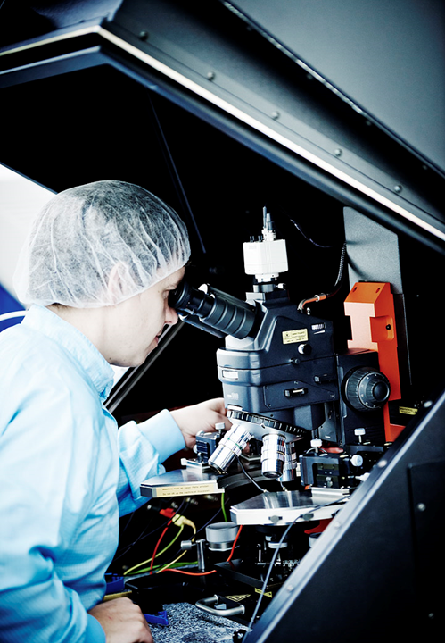
ES Status E-joint technology and system
David stopped working at the Exo-Aider project before summer.
ES Team as of 26/08/19:
Karl Damkjær Hansen
Letizia Marchegiani
Simon Bjerre Krogh

Slide 3
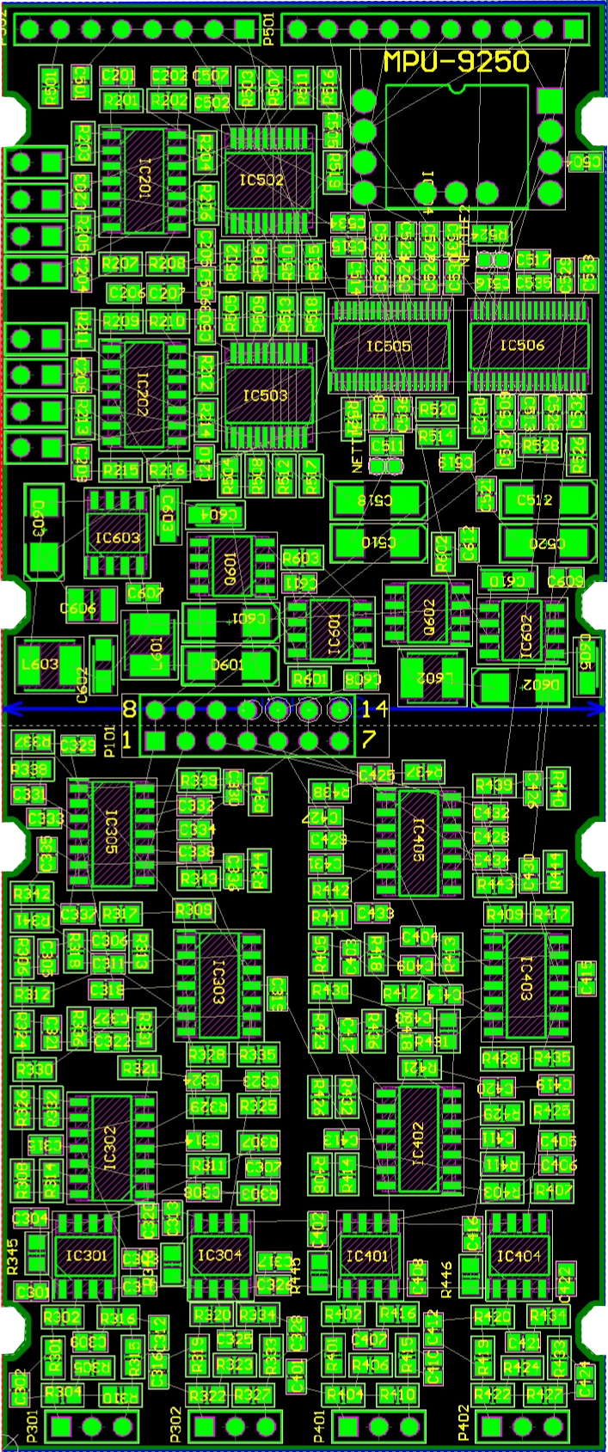
ES Status E-joint technology and system
Hardware Development
New hardware platform will be wireless (Bluetooth)
Possible to make an APP for controlling the system.
FSR will have programmable gain
Higher resolution.
Communication with hardware possible through MATLAB
Possible to use Python for extensive machine learning
Safety improvement (battery)
No connection to power outlet
Sampling frequency up to 1 kHz for each channel
4 Surface Electromyography
12 Force Sensing Resistor

Slide 4
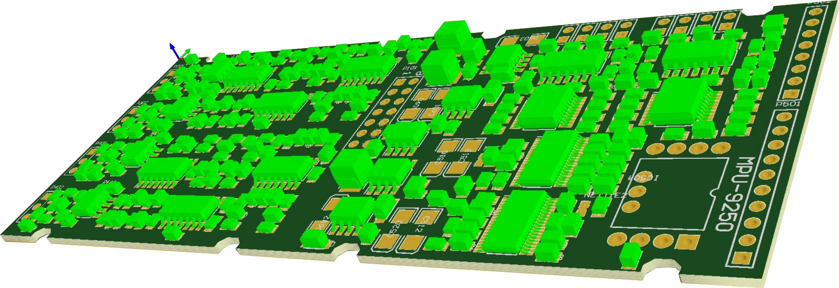
ES Status E-joint technology and system
Hardware status
Schematic capture complete
Subsystem testing
Driver for Digital to Analog Converter finished
Driver for Analog to Digital Converter under construction
Analog filters simulated through LT-Spice
Timeline
First prototype estimated ready week 41

Slide 5
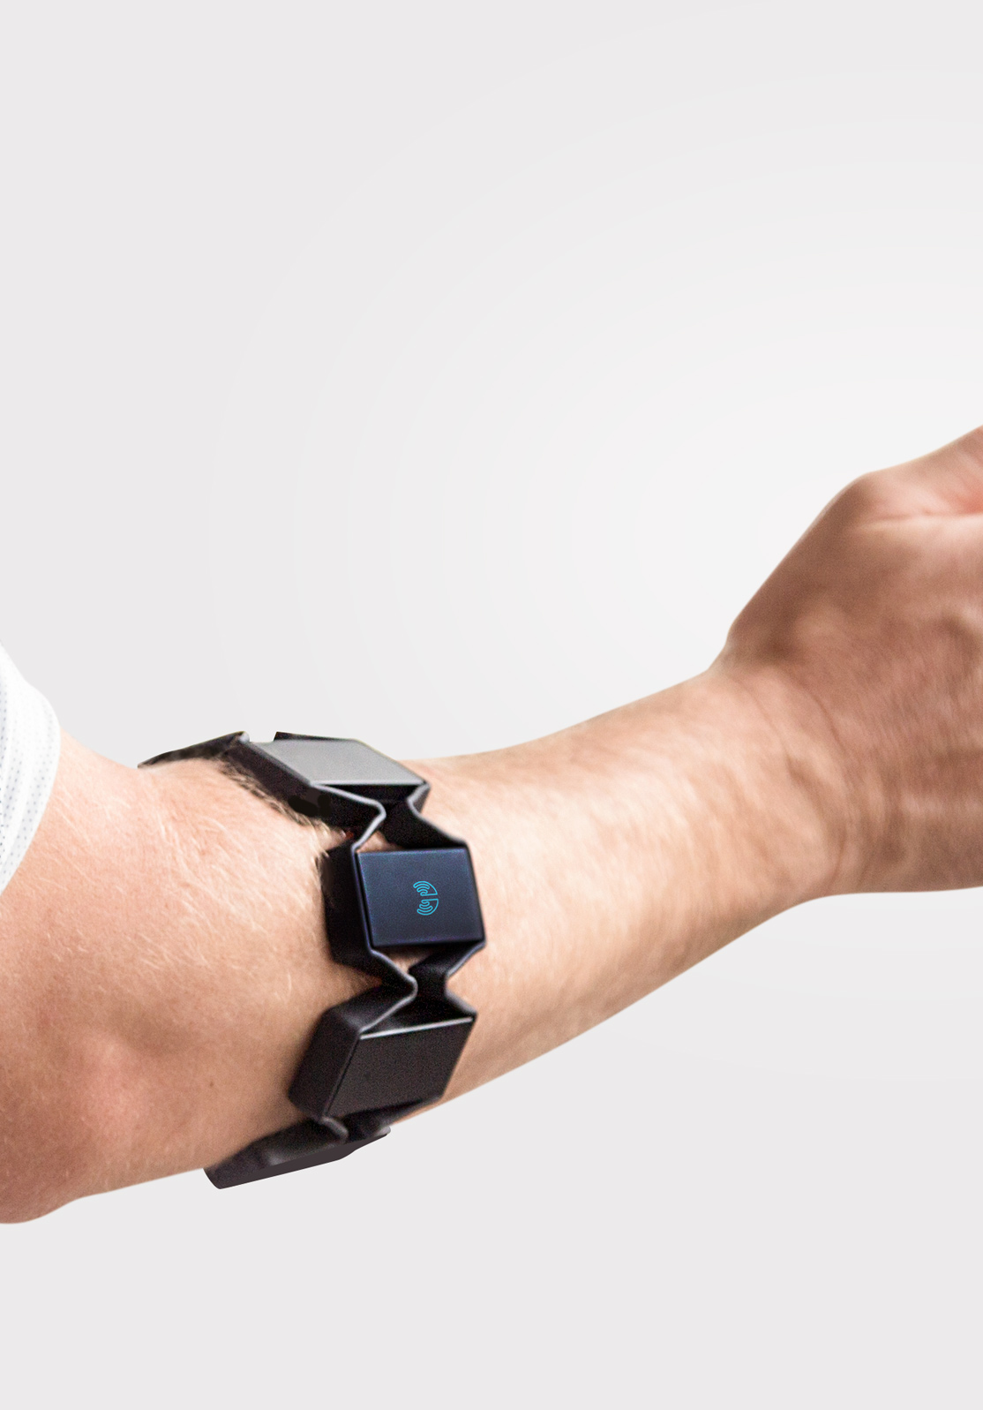
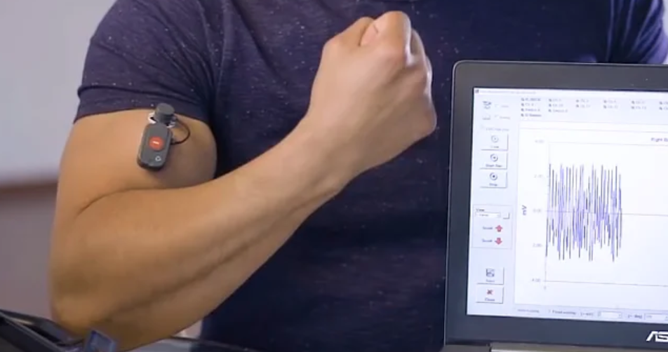
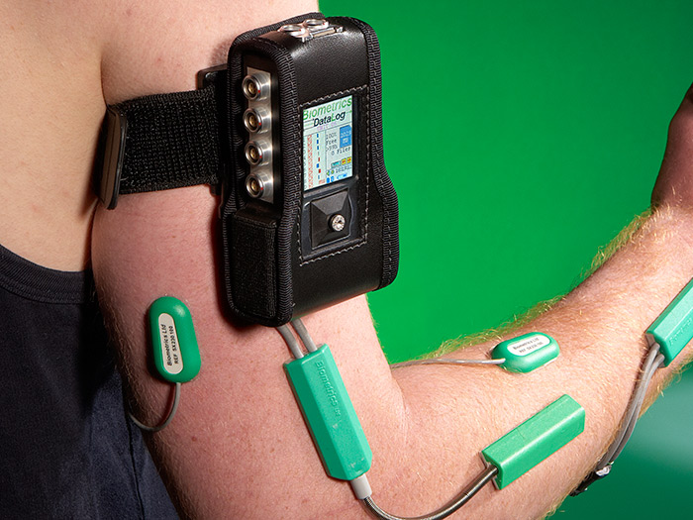
Business Opportunity
Discontinued Myo Armband, very much used in education and research.
Affordable
Open Bluetooth Protocol
Software Development Kit available
Only expensive alternatives
FREEEMG
Biometrics Ltd.

